Slide 1
The Chemical Evolution of Star-Forming Regions
Robin Garrod
September 7, 2010
Herschel and the Formation of Stars and Planetary Systems
Notes:
SF regions are a crucible of almost every element of astrochemistry yet considered!!!

Slide 2
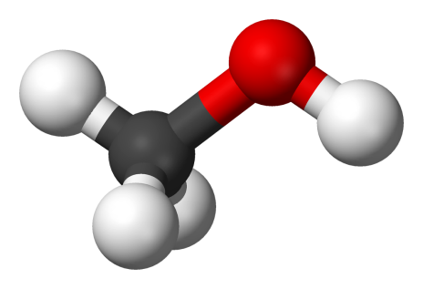
What and where?
Simplicity → Complexity
Simple molecules (<6 atoms)
Complex molecules (≥6 atoms) – my particular concern
Gas-phase and grain-surface/ice molecules
Hot cores
[e.g. Blake et al. (1987); Nummelin et al. (2000)]
Hot ‘corinos’ (low mass)
[Cazaux et al. (2003); Bottinelli et al. (2004, 2007), etc.]
‘Luke-warm’ cores (e.g. L1527)
[Sakai et al. (2007, 2008…), Hassel et al. (2008)]
Outflows, shocks
[e.g. Arce et al. (2008)]

Slide 3
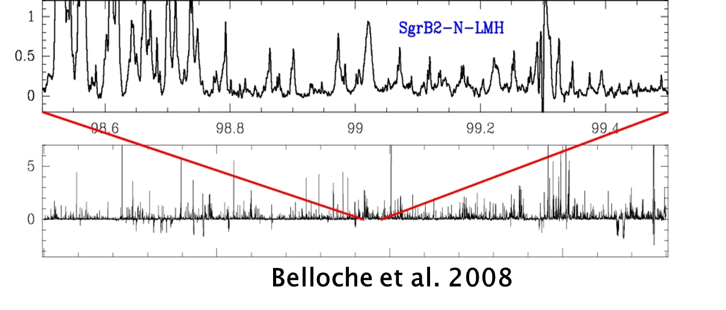
Hot Cores
Star-forming regions (typically high-mass)
Hot (>100 K), dense gas (~10⁷ cm⁻³)
Rich mm, sub-mm spectra
Sgr B2(N) – “Large Molecule Heimat”:
- Richest source for complex organics
Chemistry: gas-grain interactions
Typically: spatially unresolved chemical structure within hot-core proper
Notes:
Obvious chemical novelty is complex molecules
Sgr B2N itself may have at least 2 cores

Slide 4
Hot Core Structure
~0.01 pc
~5 x 10¹⁷ cm
~0.1 - 1 pc
Extended Component
Cold Outer Envelope
Ices:
H₂O, CH₃OH, NH₃
Some Gas-Phase Complex Organics:
e.g. H₂CO, HCOOH
Ices:
H₂O, CO, CO₂, H₂CO, CH₃OH,
NH₃, CH₄
Hot Core
Complex Organics
No ices
10² – 10³ K
20 – 100 K
10 – 20 K
20 – 100 K
10 – 20 K
Highly Processed Ices
“Pristine” Ices

Slide 5
What is chemically unique about star-forming regions?
Complex organic molecules
e.g. HCOOCH₃, C₂H₅OH, HCOCH₂OH, HCOOC₂H₅,…
(~ 10⁻¹⁰ – 10⁻⁸ / H₂)
Saturated vs. unsaturated
e.g. C₂H₅CN vs. HC₃N
→ H-saturation a good signpost of grain-mediated processes
‘Luke-warm’ cores may be an intermediate stage
Strong spatial differentiation of certain species
Methanol – even more abundant in hot cores (10⁻⁶ – 10⁻⁵ / H₂)
Other species also likely derive from sublimated ices
Understanding gas-grain interactions is crucial
→ require more ‘holistic’ approach
Notes:
Dark clouds have ‘large’ carbon chains, but ‘complexity’ is not so great compared to saturated species.
Hot cores show molecules that may be very familiar from terrestrial chemistry lab.
H-saturation seems to be a strong signpost of grain activity

Slide 6
Ice compositions
Gibb et al., 2004
Also, Boogert et al. (2008) found up to 30% methanol in several low-mass YSO’s, using Spitzer

Slide 7
Historical treatment of hot-core chemistry Millar et al. (1991), Charnley et al. (1995), and others
>100 K
Ice formation
(atomic hydrogen dominates)
O + 2H → H₂O
C + 4H → CH₄
CO +2H → H₂CO
H₂CO + 2H → CH₃OH
Temperature
Rich, fast gas-phase chemistry
(esp. H₂CO, CH₃OH)
Complex molecules formed in ≳10⁴ yr
Evaporation
~10 K
Isothermal collapse
Time
Protostellar
Switch-on?

Slide 8
Gas-phase chemistry
Gas-phase chemistry is generally successful!
Small molecules are well-reproduced in particular (in many ISM regions), as well as larger unsaturated molecules
Ion-molecule reactions:
- Driving force for simple molecule formation (<5 atoms)
- Much worse for complex molecules (≥6 atoms)
- NB: H₂ is crucial to g-p chemistry;
H₂ is formed on grains!

Slide 9
What’s up with gas-phase chemistry?
Chemical:
Key gas-phase ion-molecule rates too slow to form observed complex molecules (methanol, methyl formate)
(see Luca et al. 2002, Horn et al. 2004)
Experimental BRs of electronic recombination of molecular ions
→ multiple fragments (only ~5% methanol, dimethyl ether)
(Geppert et al. 2006, Hamberg et al. In prep.)
NB: Ion-molecule chemistry of large molecular ions is largely unexplored
Observational:
Infall time-scales too short for gas-phase rates ≲10⁴ yr
(Schoier et al. 2002, Bottinelli et al. 2004. Also Aikawa et al. 2008)
L1157 chemistry: <2000 yr at T>100 K
(Arce et al. 2008)
Methanol
CH₃⁺ + H₂O → CH₃OH₂⁺ + hν
Methyl formate
CH₃OH₂⁺ + H₂CO → [HCOOCH₄]⁺ + hν
Too slow!
15,000K barrier!

Slide 10
What’s up with gas-phase chemistry?
Chemical:
Key gas-phase ion-molecule rates too slow to form observed complex molecules (methanol, methyl formate)
(see Luca et al. 2002, Horn et al. 2004)
Experimental BRs of electronic recombination of molecular ions
→ multiple fragments (only ~5% methanol, dimethyl ether)
(Geppert et al. 2006, Hamberg et al. In prep.)
NB: Ion-molecule chemistry of large molecular ions is largely unexplored
Observational:
Infall time-scales too short for gas-phase rates ≲10⁴ yr
(Schoier et al. 2002, Bottinelli et al. 2004. Also Aikawa et al. 2008)
L1157 chemistry: <2000 yr at T>100 K
(Arce et al. 2008)
Methanol
CH₃OH₂⁺ + e⁻ → CH₃OH + H (50 – 100%)
3 %
→ CH₂ + H₂O + H
→ CH₃ + OH + H
→ CH₃O + H₂
...others...

Slide 11
What’s up with gas-phase chemistry?
Chemical:
Key gas-phase ion-molecule rates too slow to form observed complex molecules (methanol, methyl formate)
(see Luca et al. 2002, Horn et al. 2004)
Experimental BRs of electronic recombination of molecular ions
→ multiple fragments (only ~5% methanol, dimethyl ether)
(Geppert et al. 2006, Hamberg et al. In prep.)
NB: Ion-molecule chemistry of large molecular ions is largely unexplored
Observational:
Infall time-scales too short for gas-phase rates ≲10⁴ yr
(Schoier et al. 2002, Bottinelli et al. 2004. Also Aikawa et al. 2008)
L1157 chemistry: <2000 yr at T>100 K
(Arce et al. 2008)

Slide 12
Warm-up models of hot-core chemistry
Viti et al. (2004)
→ considered warm-up phase
→ differential desorption of complex species as per Collings et al. (2004)
Model: Timescales governed by
protostellar switch-on timescale
Collings et al., 2004

Slide 13
Viti, Collings, et al. results
‘Jumpy’ chemistry
Strong temperature dependence
Only half (or less) of the story
Viti et al., 2004

Slide 14
Effects of temperature
Some species ‘stick’ to grains; others not
Species-specific evaporation
Structural changes within the ice
→ affects evaporation, penetration of reactants into ice
Changing mobility of reactants
Perhaps some effect on barrier-mediated reactions (with low barriers)
Understanding how temperature changes as star-formation occurs is very important!

Slide 15
Warm-up models of hot-core chemistry
Garrod & Herbst (2006) – considered warm-up phase to increase mobility of large, molecular surface radicals.
Full gas-grain code, plus:
CH₃ + CH₃O → CH₃OCH₃
HCO + CH₃O → HCOOCH₃
HCO + OH → HCOOH
(as per Allen & Robinson, 1977)
→ successful formation of DME, MeF, HCOOH
→ radicals produced mainly by cosmic-ray induced photodissociation of ices
→ some hydrogenation of CO, H₂CO

Slide 16
Step function vs. Warm-up
Garrod & Herbst (2006)
>100 K
Temperature
~10 K
Time

Slide 17
Surface-production scheme
1) Ices: Formed during collapse phase. (CH₃OH, CH₄, NH₃ - and H₂O of course)
2) Cosmic-Ray-induced photodissociation
→ functional-group radicals
3) Gradual warm-up of hot core (10 - 200K)
4) Increased mobility
→ addition of radicals
5) Evaporation at higher temps
hν

Slide 18
New surface processes (Garrod, Widicus Weaver & Herbst, 2008)
Primary surface radicals:
H, OH, CO, HCO, CH₃O, CH₂OH, CH₃, NH, NH₂
Primary
Primary
Photodissociation
“2-Group” Molecule
Secondary
Primary
Methyl Formate
Ethanol
Formic Acid, etc.
Photodissociation
“3-Group” Molecule
Secondary surface radicals:
e.g. CH₃CO, COOH, NH₂CO, ...
Acetone
Acetic acid
Acetamide, etc.

Slide 19
Gas-Grain Chemical Model
Fully-coupled gas-phase and grain-surface chemistry.
Calculate time-dependent abundances of every species,
in gas phase and on grains, using rate-equation method
Assumptions:
Single grain size, a = 0.1 μm
Amorphous ice surface
(data: Collings et al. 2004)
⇒ Provides accretion rates,
number of binding sites, S =10⁶
⇒ Provides desorption energy, E_{D}
⇒ Provides diffusion barrier, E_{b}
Resultant Rates:
Accretion
k_{acc} ∝ a².T_{K}^{1/2}
Reaction
k_{reac}∝ exp[-E_{b,1}/T]/S
+exp[-E_{b,2}/T]/S
Thermal Desorption
k_{des} ∝ exp[-E_{D}/T]
Photodissociation
k_{CR} ∝ ζ
hν

Slide 20
Complex chemistry model
OSU 2005 rates
50 new neutral species + 32 gas-phase ions
Many surface reactions already present; mostly atomic addition
New chemistry:
- Ion-molecule reactions with He⁺, C⁺, H₃⁺, HCO⁺, H₃O⁺
(rates as per Herbst & Leung 1986)
- Dissociative recombination of resultant ions,
guided by Geppert (2006) results
(5% channel retains complex structures)
- Cosmic-ray induced photodissociation:
both gas-phase and grain-surface molecules (use g-p rates)
- Large range of radical-addition surface reactions
Notes:
For those of you who do chemical modelling, or who take a perverse interest in this sort of thing…!

Slide 21
Two-stage physical model
Isothermal collapse, n_{H} = 3 x 10³ → 10⁷ cm⁻³
Warm-up from 10 – 200 K, over 2 x 10⁵ yr
200 K
Temperature
Warm-up
(after Viti et al. 2004)
10 K
Isothermal collapse
Time

Slide 22
Model Results
Envelope
Extended Component
Hot Core
Gas Phase
Grain Surface
Chemical model:
Parcel of in-falling gas.
Represents history of parcel,
or current snapshot through the hot core
Warm-up Phase: 10 – 200 K

Slide 23
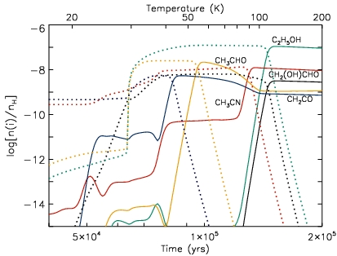
Good match to
observations:
10⁻⁹ – 10⁻⁷
“Light” species: extended
“Heavy” species: compact
Some early evaporation
H₂CO evaporates→ chemistry
HCO, CH₃ radicals: mobile
20 – 40 K is crucial range for most complex molecule formation

Slide 24
Surface Routes to Complex Molecules

Slide 25
Good agreement with Sgr B2(N): abundances and temps
Species | Formula | Ref | Observed T_{rot} | Observed n(i)/n_{H}* |  | Peak model T (K) | Peak model n(i)/n_{H}
Formaldehyde | H₂CO | 1 | 50 | 2.5(-10) |  | 42 | 1.6(-6)
Methanol | CH₃OH | 1 | 238 | 8.3(-7) |  | 117 | 2.6(-6)
Acetaldehyde | CH₃CHO | 1 | 59 | 7.3(-11) |  | 54 | 3.0(-10)
Acetic acid | CH₃COOH | 2 |  | 8.5(-11) |  | 120 | 9.0(-11)
Methyl formate | HCOOCH₃ | 2 |  | 2.0(-9) |  | 80 | 1.9(-10)
Glycolaldehyde | HCOCH₂OH | 4 |  | ~2(-11) |  | 200 | 2.5(-11)
Dimethyl ether | CH₃OCH₃ | 1 | 197 | 1.3(-9) |  | 200 | 6.4(-9)
Ethanol | C₂H₅OH | 1 | 73 | 7.0(-10) |  | 120 | 3.8(-9)
Ethylene glycol | (CH₂OH)₂ | 3 |  | 3.3(-10) |  | 171 | 9.7(-11)
Isocyanic acid | HNCO | 1 | 212 | 2.8(-10) |  | 200 | 1.3(-9)
Methylamine | CH₃NH₂ | 1 | 230 | 2.5(-6) |  | 120 | 2.6(-7)
* Scaled to 23’’ beam size
1=Nummelin et al. (2000); 2=Snyder et al. (2002)
3=Hollis et al. (2002); 4=Hollis et al. (2000)

Slide 26
Methanol is crucial (still)
Methanol is (most) important parent
CR-induced photodissociation of ices ⇒ complex molecules
Longer timescales (at 20 – 40K) → more abundant complex molecules
Currently assume gas-phase PD rates
What fraction gives CH₂OH ? (40%)
CH₃O ? (40%)
CH₃ ? (20%)
Use experimental/modelling techniques to get methanol BRs
Öberg et al. (2009) – ice-phase experiments
Garrod & Öberg (in prep.) – ice-phase models of experiments
Laas et al. (in prep.) – gas-phase experiments & models

Slide 27
Still not a simple picture...
Dimethyl ether may be formed in gas phase:
CH₃OH₂⁺ + CH₃OH → CH₃OCH₄⁺ + H₂O
CH₃OCH₄⁺ + e⁻ → CH₃OCH₃ + H (5%)
Observed rotational temps of
~200 K are in agreement
Evaporation of surface-formed DME
Gas-phase formation of DME

Slide 28
Simple molecules are complicated
Differential desorption is important (more lab data please!)
H₂CO is volatile – evaporates at ~40 K.
Stimulates gas-phase chemistry (esp. HCOOH).
Survival to higher temps is dependent on warm-up timescale.
Multiple gas-grain feedbacks can be important!
Short
Mid
Long

Slide 29
Low mass vs. High mass
Use timescales to differentiate high and low mass
Few x 10⁴ to 10⁶ years = chemical timescale
Long timescales at low temps (20-40K) and short timescales at high temps (70+) are pre most productive
Require good estimates of temp/density time dependence (as per Aikawa et al., 2006)
Short
Mid
Long
Notes:
Intermediate timescale probably just represents a happy medium between long time of formation at early times and short time of destruction at late times

Slide 30
Sulphur-bearing species as chemical clocks?
Suggested by many authors
Ejection of H₂S from grains leads to formation of SO, SO₂, etc. in hot cores
Ratios may indicate age of core
Perhaps HNCO:CS – observers suggest correlation (modelling: Tideswell et al. 2009)
Sulphur budget in dense medium is too small
(Wakelam et al.)
Do not know dominant form of sulphur

Slide 31
How does ice composition affect subsequent chemistry?
Experiments: Öberg et al., 2009
UV irradiation of methanol and mixed ices
Much chemistry occurs within mantle (i.e. beneath surface)
Notes:
My own modest involvement (at least) was motivated by a desire to test complex-molecule formation routes

Slide 32
Surface Routes to Complex Molecules

Slide 33
How does ice composition affect subsequent chemistry?
Not just composition: structure
If photoprocessing is important, different layers will produce different chemistry
Methanol and CO dominated species (i.e. HCOOCH₃) may dominate outer layers (and thus gas-phase too) until break-up of ice structure
Deepest layers may be preserved until latest times
Need to get even the basic surface chemistry right at earliest stages
How is ice processed prior to warm-up phase?
→ Öberg’s experiments show complex-molecule production even at low temps (20K)
H₂O
CO₂
CH₄
CO
H₂CO
CH₃OH
GRAIN
CO

Slide 34
Cold complex chemistry
Detections in Sgr B2N (by Hollis+, 2000, 2001, 2004 ) of cold, extended glycolaldehyde (HCOCH₂OH), ethylene glycol ([CH₂OH]₂)
Spatial extent ~60 arcsec (?)
Temps as low as 10 K (?)
Shocks?
Detections by Öberg et al. (2010) of cold (10 K) methyl formate (HCOOCH₃) and acetaldehyde (CH₃CHO) in low-mass protostar B1-b
Suggest that HCO-bearing species are result of cold chemistry
Photo-processing may be important
Need very careful analysis of experimental data to understand cold complex chemistry
At 10 K, photons may be responsible for mobilisation of reactants as well as their production…
Notes:
Most of the authors are in the audience

Slide 35
Shocks
Sgr B2N: Good evidence for shocks (e.g. Sato et al., 2004; Mehringer & Menten,1997)
Complex molecules in apparently shocked GC molecular clouds (Requena-Torres et al. 2006, etc)
Arce et al. (2008) find complex molecules in protostellar outflow (L1157)
Can we say how molecules are formed?
Can we say how molecules are ejected/sputtered?
Can we say how long molecules can survive?
Need very specific data about:
the nature of the shocks,
destruction of complex molecules at high temps
sputtering specifics
→ understanding of complex shock chemistry will be led by observers for the time being…
Notes:
Temperature changes within shocked regions on timescales of 100’s to 1000’s of years, with temperatures from 10’s to 1000’s of Kelvin.

Slide 36
Conclusions
Surface/ice chemistry are crucial parts of IS organic chemistry
Interaction with gas-phase must be treated explictly
UV irradiation important for complex molecules
Chemistry in SF regions appears strongly temperature dependent
→ Can explain elements of temperature/spatial structure
Methanol (formed on grains) provides chemical building blocks for more complex species
We need:
Focussed co-operation between experiments and models – neither can provide answers alone
To consider structure of ices as well as composition
To consider chemistry of ices throughout their history

